Slide 1
MT 2 Economics Project
Dulce Contreras and Daniel Baca

Slide 2
How did you decide on product?
We wanted something unique
Something that people would want to buy
We decided that making something sweet would be in high demand
Wanted something easy to make
Decided on Kabobs

Slide 3
Business Model
Partnership
Dulce can be the manufacturer
Daniel can be the supplier and seller
Sole Proprietor
Too much work for one person
Neither one of us has all the skills necessary
Corporation
Cannot sell stocks
Not a big enough business

Slide 4
How did having a Partnership help you?
Dulce was able to apply her knowledge about baking and Food Services to make the Kabobs.
Daniel was able to use his resources to purchase supplies and his connections to sell the Kabobs.

Slide 5
Name of business
Sweet Treat Kabobs
By
Dulce Contreras and Daniel Baca

Slide 6
Slogan
“When you need something sweet, this is the treat!”

Slide 7
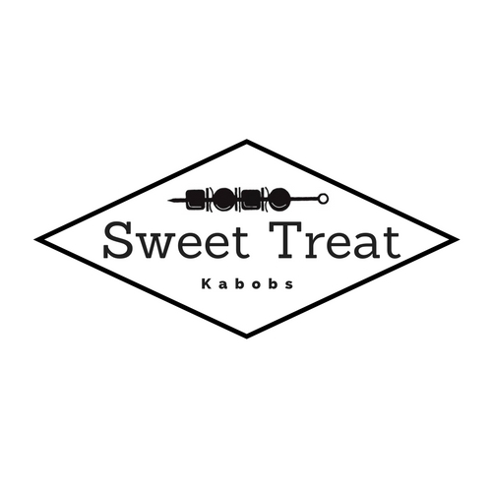
Logo

Slide 8
Magazine Ad
https://www.canva.com/design/DACCHkb7y8c/87SH_6IJqSaennp-NvZeAA/view?utm_content=DACCHkb7y8c&utm_campaign=designshare&utm_medium=link&utm_source=sharebutton

Slide 9
Commercial
https://splice.gopro.com/v?id=01g3awn1E

Slide 10
How did you decide how much to produce?
Daniel purchased the supplies to make the Kabobs and Dulce made as much possible with the the supplies.
In the first round 36 Kabobs were produced with some leftover supplies
In the second round new supplies were purchased to replace the ones that ran out and all supplies were used by the end. 23 Kabobs were made.

Slide 11
Demand Schedule
Demand Schedule | Would buy | Profit made
$1.00 | 3 | -$13.00
$1.50 | 2 | $3
$2.00 | 1 | $19.00
$2.50 | 1 | $35.00
$3.00 | 1 | $63.00
Demand Schedule | Would buy | Profit made
$1.00 | 3 | $23.00
$1.50 | 2 | $35
$2.00 | 1 | $46.00
$2.50 | 0 | -$57.50
$3.00 | 0 | -$69.00

Slide 12
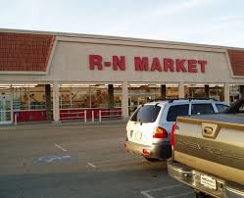
Suppliers of Supplies
Dollar Tree
R-N Market

Slide 13
Supplies and Total Costs
Total money used for supplies: $56.46
Marshmallows: $14.38 for 8 bags
Hershey's Chocolate: $17.38 for 22
Kabob sticks: $1.08 for 100 sticks
Strawberries: $9.90 for 5 boxes
Rice Krispies Cereal: $5.69 for 1 box
Bags: $2.16 for 50
Sprinkles: $3.58 for 2
Butter: $2.29

Slide 14
How did we choose our price?
In the first round we added the total amount of money spent on supplies and divided it by the number of Kabobs made.
It cost around $1.40 to make each Kabob so in order to maximize profits we placed the price at $3.00.

Slide 15
Cost of Production (Time)
1st Round: 36 Kabobs
Time = 7 hours
2nd Round: 23 Kabobs
Time = 4 hours

Slide 16
Market Structure
Oligopoly
Very differentiated products
Few suppliers
Have a big influence on price
Have a big amount of market power

Slide 17
Revenue from sales
1st Round: $108
36 @ $3.00
2nd Round: $53
7 @ $3.00
16 @ $2.00

Slide 18
Surplus
In the second round we did not have enough people that were willing to buy the kabobs at $3.00 so we decided to lower the price to $2.00
We sold 7 Kabobs at $3.00
We sold 14 Kabobs at $2.00

Slide 19
How did demand play a role in pricing?
On our demand schedule we noticed that people would be willing to buy one Kabob at $3.00, $2.50, and $2.00
In order to have a bigger profit margin we priced them at $3.00 and made $108.00 in revenue
We sold the 1st round Kabobs on a Tuesday when we had a larger number of customers, therefore having a larger demand. We sold the 2nd round of Kabobs on a Friday where we had a fewer number of customers and a lower demand.

Slide 20
In real life would you choose a partnership?
In real life Daniel would not have the baking skills and patience to mass produce Sweet Treat Kabobs
In real life Dulce would be able to make the Kabobs but not sell them
We rely on each other to help fill our gaps and if we did this in real life we would still choose a partnership

